Slide 1
Study of Encryption algorithms and implementation using IPsec tunnelling
Anirudh Nagulapalli

Slide 2
Contents
Introduction
Cryptography
Encryption Algorithms
MD5 Algorithm
DES Algorithm
3DES Algorithm
AES Algorithm
Setting up the network
Conclusion
References

Slide 3
Introduction
The ultimate goal of a successful encryption algorithm is to provide the network, security from unauthorised access.
Cryptography is the science of using mathematics to encrypt and decrypt information.
Cryptography deals with writing messages secretly so that it promotes data integrity. This can be done through various ways like setting up a firewall, using various encryption

Slide 4
Cryptography
Cryptography comes from ‘kryptos’ which means ‘Secret’ and ‘graphy’ which means ‘writing
Encryption is the process in which data (plaintext) is translated into something that appears to be random and meaningless ciphertext to store on insecure media or can also be transmitted on an insecure network (like the Internet) and it cannot be read by anyone except the intended recipient.
To encrypt, the algorithm mathematically combines the information to be protected with a supplied key. The result of this combination is the encrypted data.

Slide 5
Goals of Cryptography
Confidentiality
Authentication
Data Integrity
Access control

Slide 6
Encryption - Decryption
The main concept of Cryptography consists of two parts.
Encryption
Decryption
During Encryption, a readable plain text is converted into an unreadable Cipher text using a ‘key’. This ‘key’ is called as ‘Cipher’. The number of bits of the Cipher depends upon the type of algorithm used. The Cipher text is simply a set of random integers and alphabets combined together.
During the Decryption process, the same ‘key’ is used and the Cipher text is converted to the original plain text as it is.

Slide 7
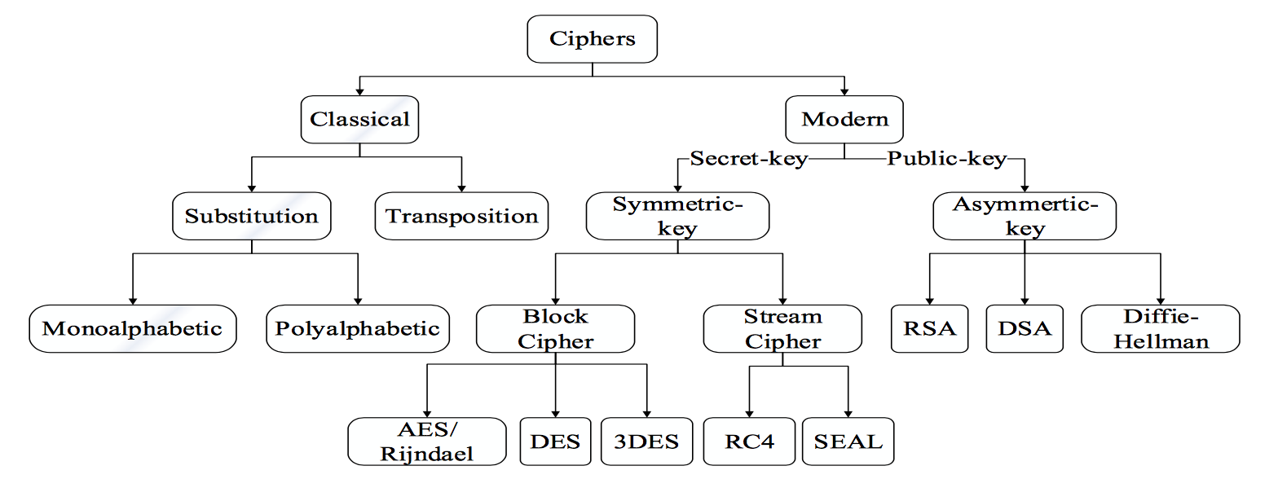
Classification of Encryption methods

Slide 8
MD5 Algorithm
The MD5 algorithm stands for Message Digest algorithm 5.
This was invented by Ronald Rivest in 1991. There are two types of hashing in MD5 algorithm.
Type 5 MD5 hashing
Type 7 MD5 hashing
The idea behind the type 7 algorithm is providing the plain text a hash function and converting it into a 128 bit MD5 hash. Also it can be easily decrypted so it’s not reliable. On the other hand type 5 hashing can be enabled using a keyword called ‘Secret’. The type 5 MD5 encryption is always a better option and can be seen below

Slide 9
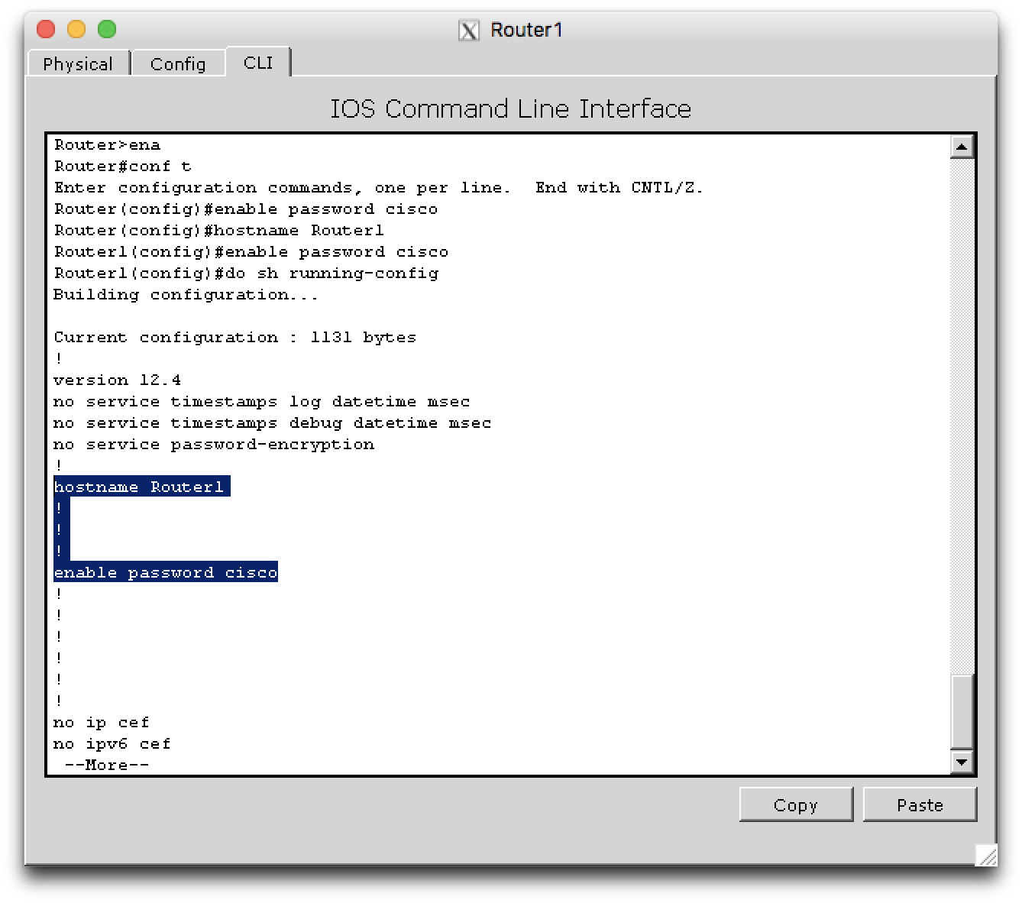
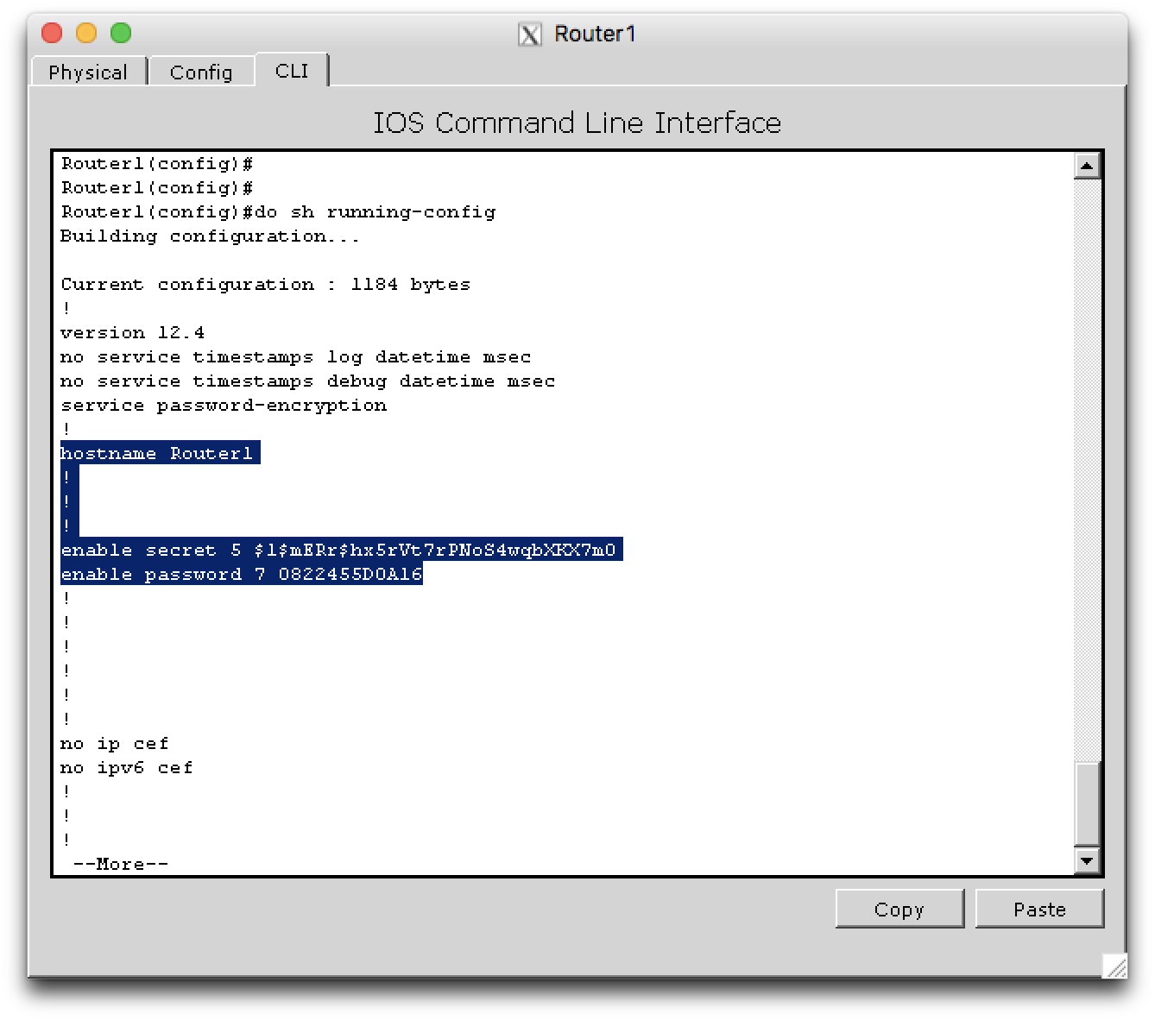
Before Password Encryption
After Password Encryption

Slide 10
DES Algorithm
The DES Algorithm or Data Encryption Standard Algorithm is initially developed by International Business Machines Corporation (IBM) and endorsed by National Bureau of Standards in 1975.
The DES is a product block cipher consisting of 16 iteration (or) rounds of permutation process are cascaded. The block size is 64 bits but only 56 bits can be chosen by the user which are the key bits. The rest 8 bits are the check bits (or) parity bits.

Slide 11
3DES Algorithm
The 3DES or Triple Data Encryption Algorithm (TDEA) was developed by International Business Machines Corporation (IBM) in 1978 so as to overcome the obvious flaws from the DES.
The DES initially used 56-bit key which wasn’t enough to encrypt sensitive data.
The new algorithm simply extends the key count to 168 which is three times of 56. Hence it uses 3 keys K1, K2 and K3 each 64 bit long.

Slide 12
AES Algorithm
AES is the new encryption standard which replaced DES in 2001.
The main advantage of this algorithm is that it supports any combination of data (128 bits) and any key length of 128, 192 and 256 bits. This algorithm is also referred to as AES-128, AES-192, AES-256 where the number depends on the length of the key.
This algorithm goes 10 iterations for 128 bit keys, 12 iterations for 192 bit keys, 14 iterations for 256- bit keys in order to generate the Cipher text during Encryption or to retrieve the plain text during Decryption. This standard was advantageous over the remaining as it provided excellent security and fast.

Slide 13
Setting up the network
The above encryption algorithms and many like these can be implemented in a Cisco Packet Tracer by setting up a IPsec VPN tunnel between two sites.
Here, the Routers 1 and 3 are in two different sites and are connected by establishing an IPsec VPN

Slide 14
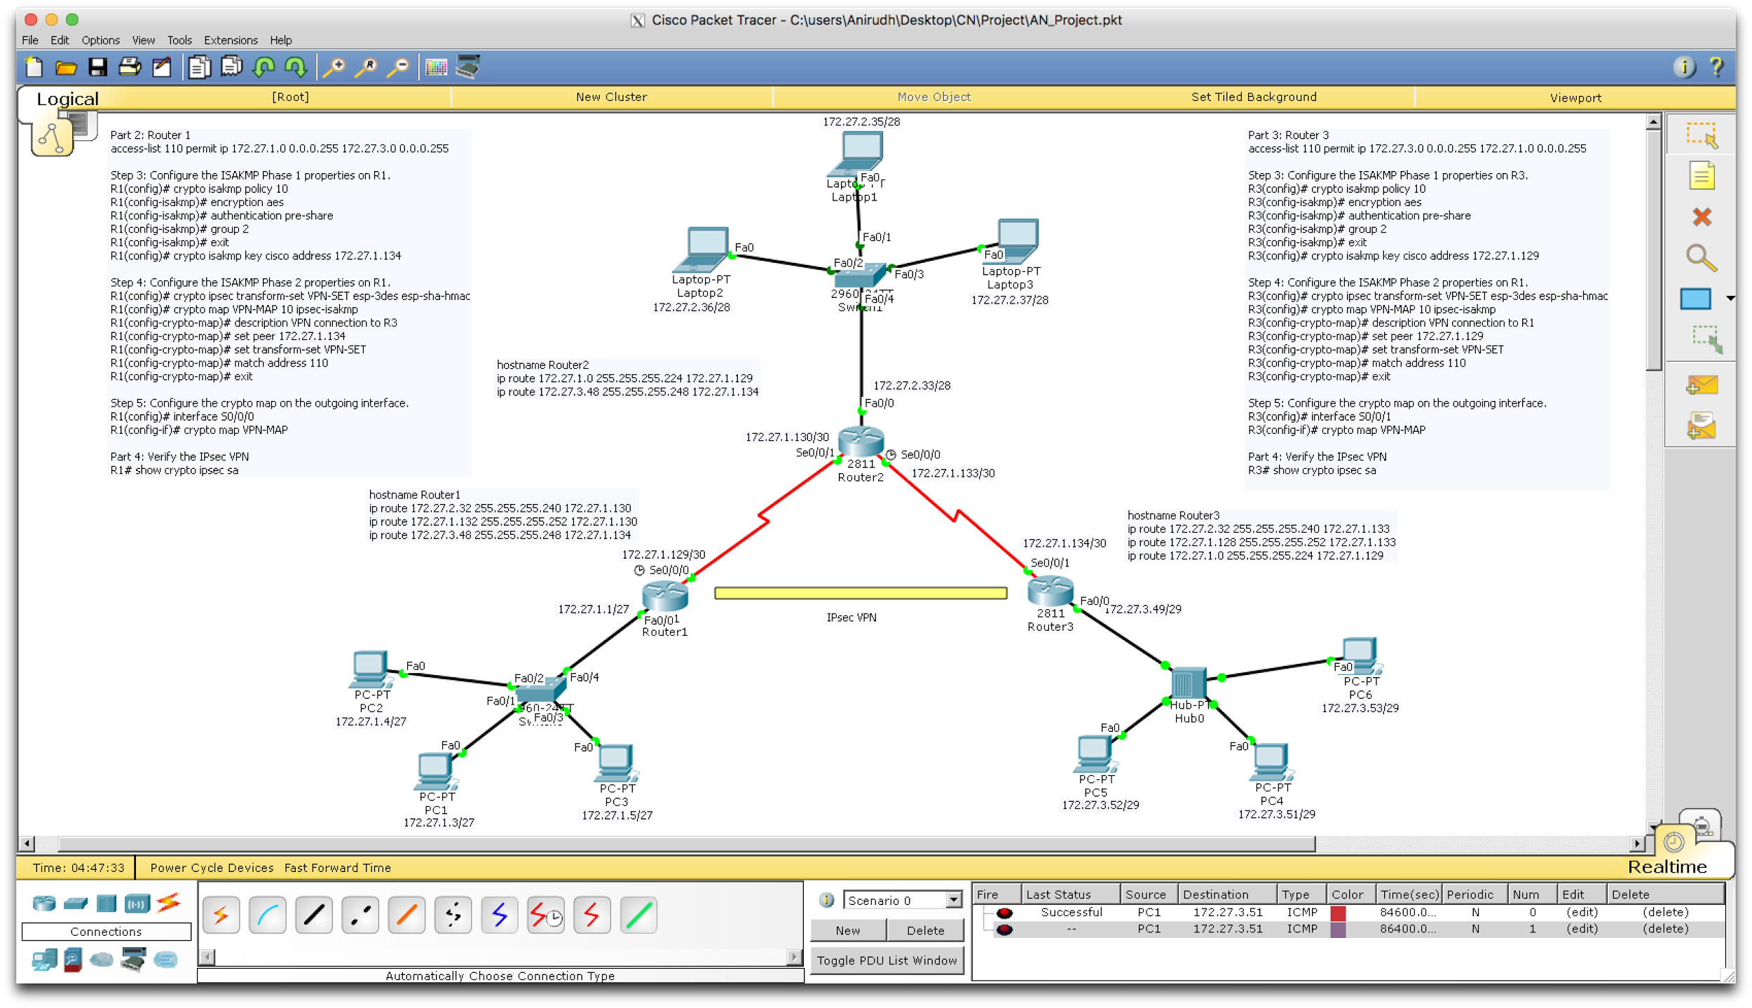

Slide 15
Objectives involved in setting up
The ISAKMP Phase 1 and 2 properties are to be configured on the respective routers.
The Phase 1 properties are generally called as ‘HAGLE’ which stands for ‘Hashing, Authentication, Group available, Lifetime, Encryption type’. After configuring the tunnel with these properties, a password has to be set which involves key [key name] [address].
The Phase 2 involves configuring the hashing algorithm, which algorithm is to be used for encryption and authentication for integrity and also giving the transform-set a name.

Slide 16
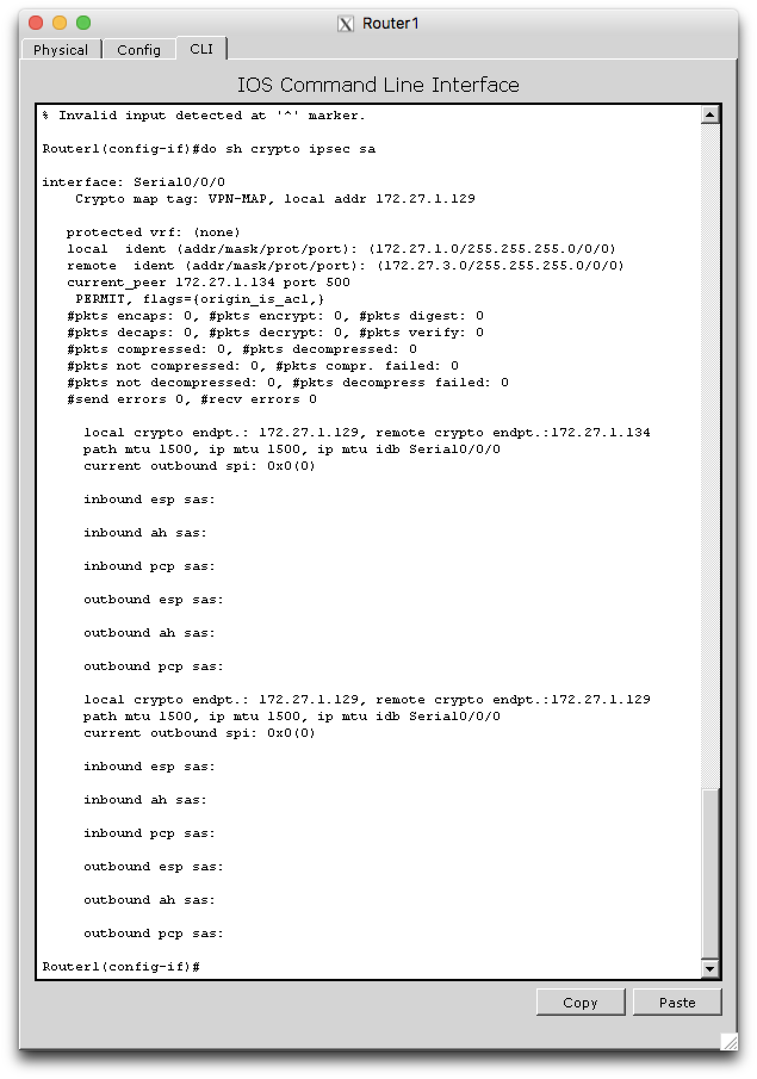
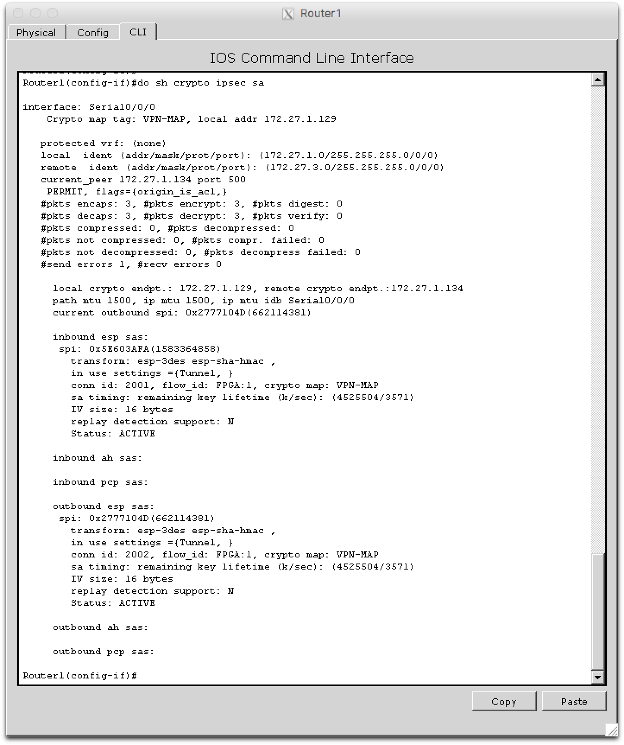
Before Router 1 PC pings Router 3 PC
After Router 1 PC pings Router 3 PC

Slide 17
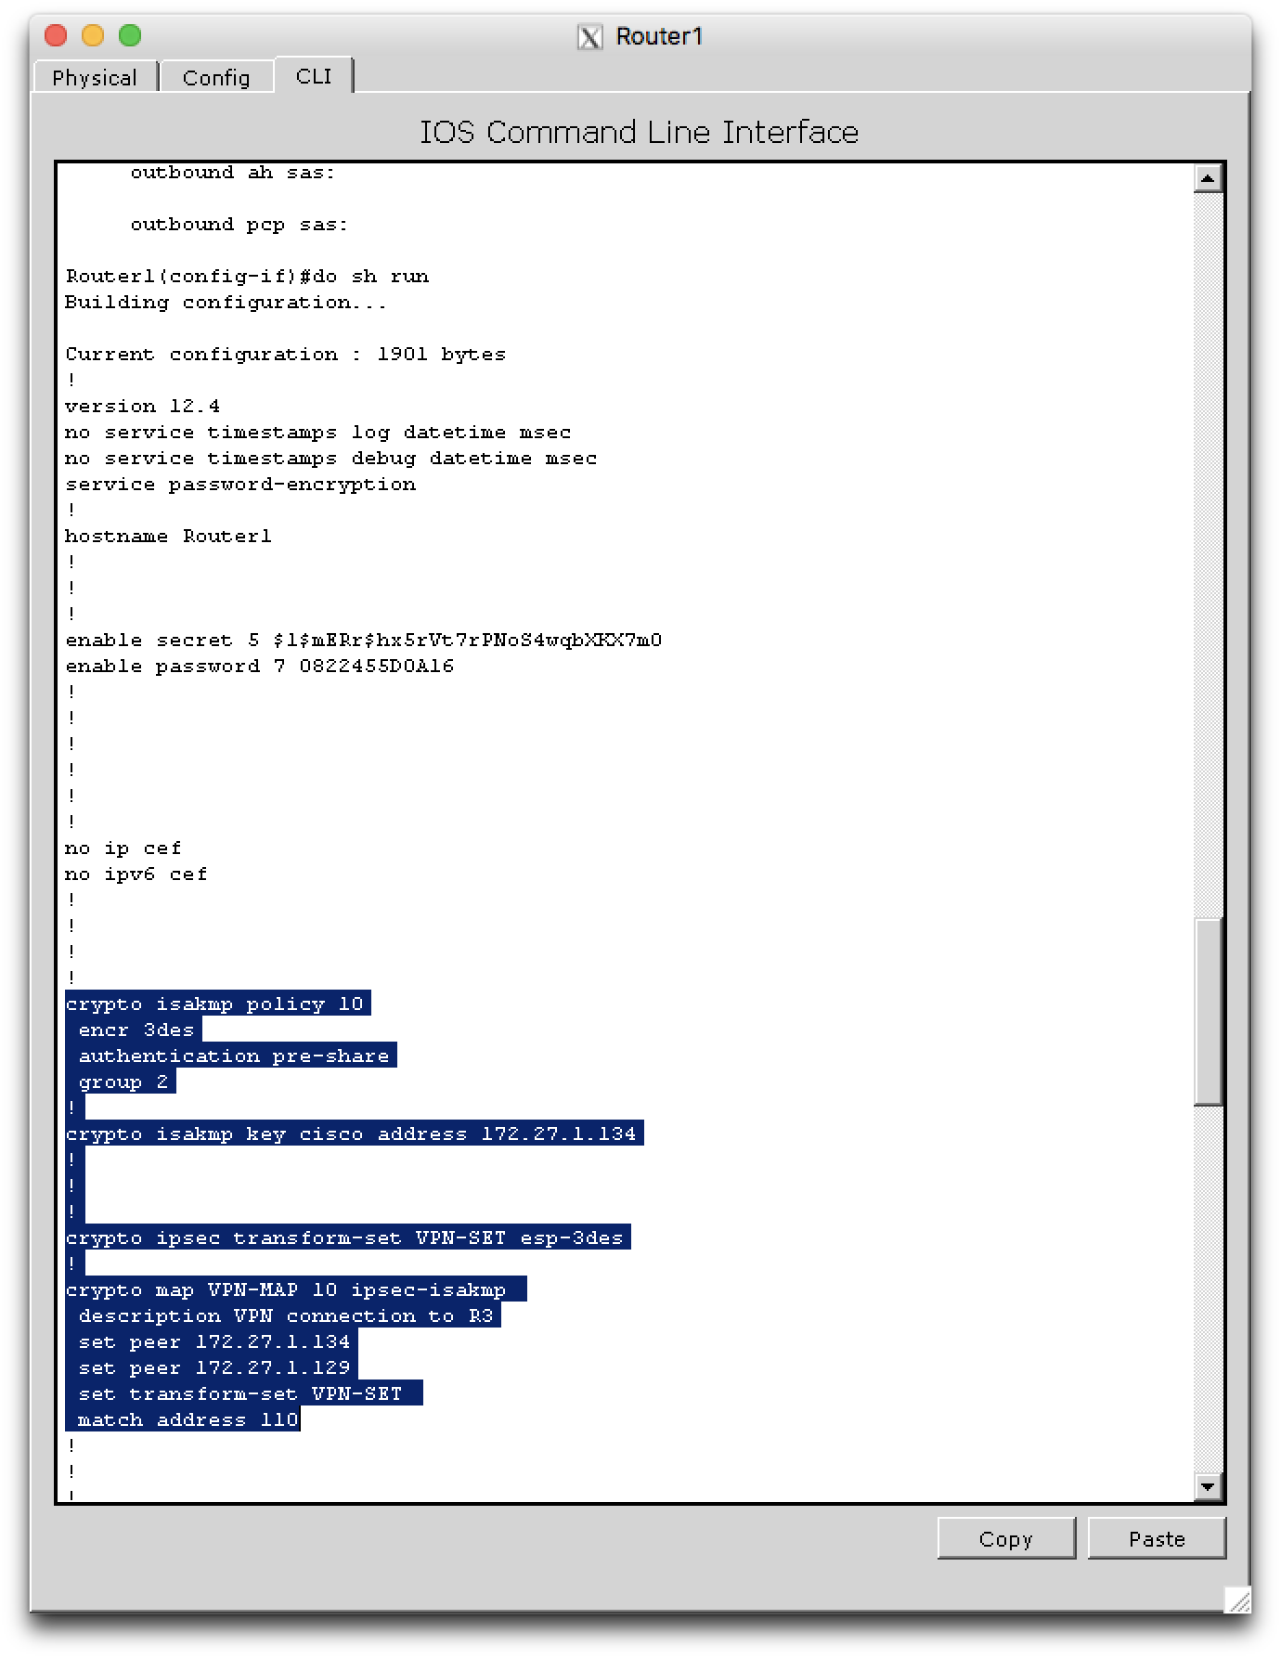
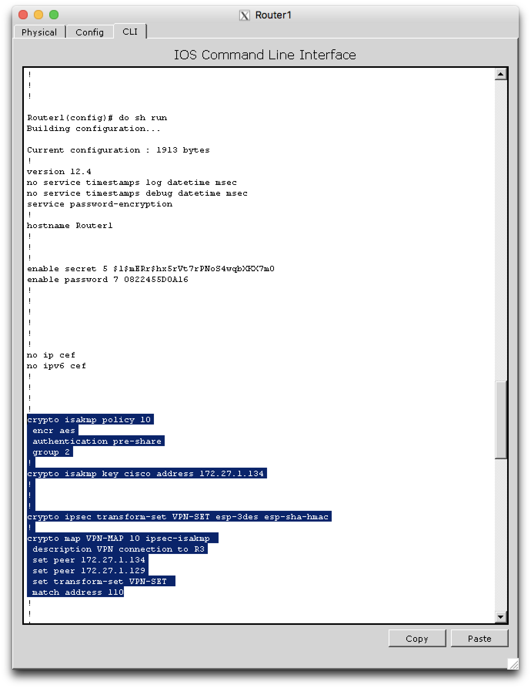
3DES Encryption
AES Encryption

Slide 18
Conclusion
As the use of internet is growing rapidly, the security threats also increase day by day. So to provide security to the network and data, different encryption methods are used.
Each and every type of algorithm is unique and has its own pros and cons. A combination of algorithms can be used to secure our data effectively.
According to a research done, AES proved to be the efficient encryption in terms of speed, time, data throughput.

Slide 19
References
New Data Encryption Standard Algorithm
Anchugam, K; Tamilselvi, M. International Journal of Computer Science and Network Security
https://en.wikipedia.org/wiki/MD5
Data Encryption Standard (DES), William L. Hosch http://academic.eb.com.online.library.marist.edu/levels/collegiate/article/475339
A Study of Encryption Algorithms (RSA, DES, 3DES and AES) for Information Security, Gurpreet Singh; Supriya, International Journal of Computer Applications
http://www.cisco.com/

